Slide 1
TSD Configuration Promoting

Slide 2
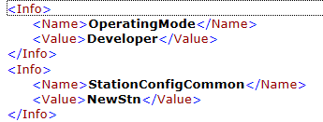
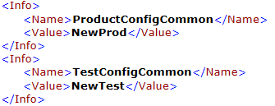


Result File Integration
The result file (XML) that is generated from the Framework has an <Information> section which is used to identify all configurations that were used and the build version, mode, etc.
Below you see an example of how the XML file would look like under the <Information> node.
In that example we see that the OperatingMode is developer and we have a configuration for each configuration type
Version is associated from the “Test System Version” in the information area and only maps to the first two (Major/Minor)

Slide 3



Web UI View
Once the result file is processed then you can go to the Version page to see exactly which configs were used.
Everything is stored and never overwritten in case you update the configuration stored in remi the linked configs aren’t lost.
If you were to look at for example the uploaded stored Product Configurations you would see two stored. See below (“NewProd” and “Other Product”).
However if you view the XML file under “Product XML” you will see that only “NewProd” is shown.
Stored Product Config
Linked Result Config

Slide 4
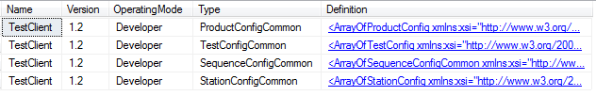
REMI Storage
We store the configurations from TSD Framework based on access methods (see next slide).
You can see below an example of how they are stored so basically each configuration is stored based on the type (Product/Test/Sequence/Station) , Version (Major/Minor) and Operating Mode

Slide 5
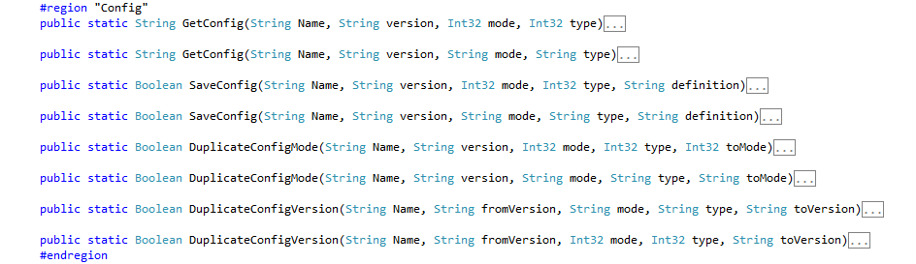
DBControl
TSD Framework has DBControl integrated so there should be no need to manually call any configuration through DBControl. However a need could arise and below is the methods that are currently available.
TSD Framework uses Get/Save/Promote configurations methods.
DBControl is based from the REMI site and uses webservices to pull.

Slide 6
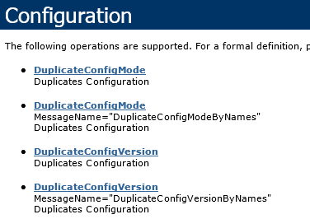
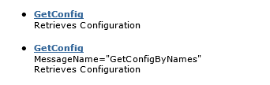
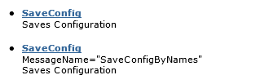
WebService Methods
The following are the web service methods that DBControl uses.

Slide 7
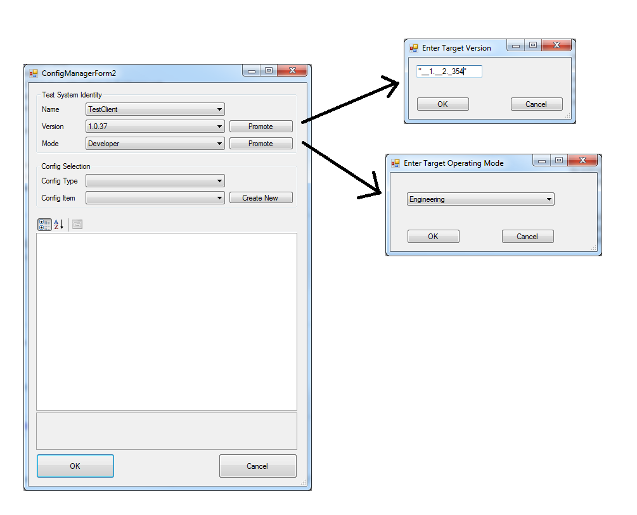
TSD Framework UI
Use the “Promote” buttons to duplicate the configuration you have selected and change their respective Mode/Version.
Version is in the format Major.Minor.Patch
Mode is “Engineering”, “Developer” and “Production”.
EG: “TestClient”\“1.0.37”\“Developer” promoted Mode selecting “Engineering” would copy the config and change the mode however both would still be available. “TestClient”\“1.0.37”\“Engineering”

